Slide 1

Ryan
Sport
Club

Slide 2
Our Team
01
Hamza Siddiqui
02
MUHAMMAD HASEEB
03
MUHAMMAD SARIB
04
MUHAMMAD SAIF ULLAH

Slide 3
Welcome to Sport Club
Participation in sports can help in relieving from stress

Slide 4
Information of Sport
Sport pertains to any form of physical activity or game
Important Of Sport
A human activity involving physical exertion and skill
Sports are a crucial part of a student's growth and development. They help in the development of mental health and physical fitness of the body. Through participation in sports and games, a student gains various skills, experience and confidence that are helpful for developing their personality

Slide 5
Sport
1
Indoor sport
Many sports are being played on this type of service, such as soccer, baseball, flag football, shooting softball, lacrosse, rugby, and many others.
Outdoor sport
2
Outdoor games are those games which are played in the open, and not in a closed environment.
Modern PowerPoint Presentation

Slide 6
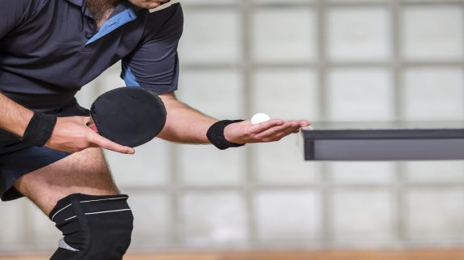



Indoor Sport
Table Tennis
01
Table tennis is the mini-version of tennis, in short. The court comprises of a rectangular wooden table having a net affixed in the middle
Chess
02
“Chess is war over the board. The object is to crush the opponents mind.”
Box Cricket
03
Cricket is a favorite outdoor sport enjoyed by a vast population around the world.
04
Badminton
A favorite indoor game in which two or four (in doubles, with two in each team)

Slide 7




outdoor Sport
Foot ball
01
Football is a family of team sports that involve, to varying degrees, kicking a ball to score a goal.
Cycle Sport
02
Cycle sport is competitive physical activity using bicycles.
Fishing
03
Recreational fishing, also called sport fishing or game fishing, is fishing for leisure, exercise or competition.
04
Camping
Camping as a recreational activity became popular among elites in the early 20th century.

Slide 8




Activity
1. Work strength and endurance
2. Train outdoors in clubs
3. Breathe, relax your mind
4. Enjoy all the benefits of swimming

Slide 9
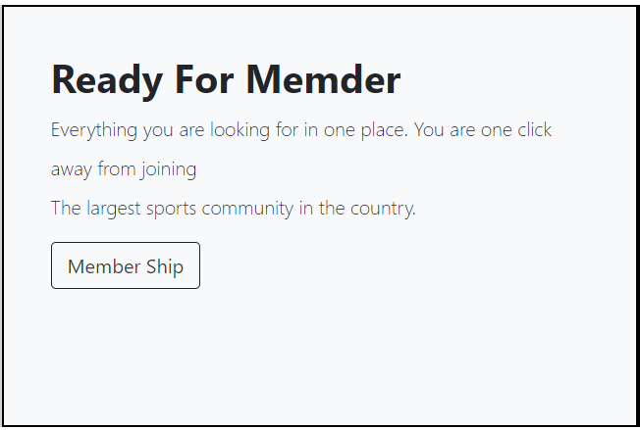


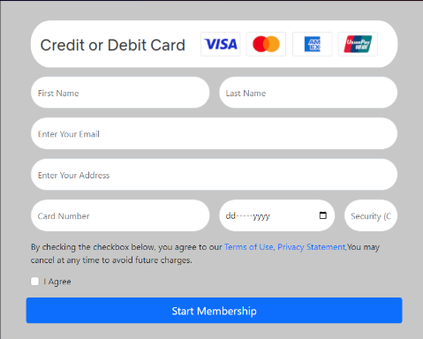
Easy Step To Start Member Ship
Ready For member
Choose your Plan
Tab the Join Btn
Enter Your Detail
Click - Here
Click - Here
Click - Here
Click - Here
Click - Here

Slide 10
Thank You

